Slide 1

Modelling knowledge
Maxime Lefrançois, Antoine Zimmermann
Ecole des Mines de Saint-Etienne
Notes:
je suis Lynda TEMAL
Je suis chez sfeir depuis un an.
J’ai un doctorat de l’université de Rennes I.
Le sujet de la thèse modélisation d’ontologies pour le partage de données dans le domaine de la neuroimagerie.
Aujourd’hui je vais vous présenter une introduction au web semantique. appelé aussi web de données.

Slide 2
Content
Introduction
Classification
Graph-based knowledge representation

Slide 3
Introduction
Why modelling knowledge?
make knowledge explicit
make it independent from a specific system
→ reusable in different systems
derive implicit information from explicit knowledge and facts
Why knowledge representation
Answer common needs that arise with the produced knowledge -> exchange, query, infer, visualize ...

Slide 4
Introduction
Examples :
an app for learning how to cook and invent new recipes, and a recipe search engine require knowledge about cooking and recipes.
a electric vehicle charging planner requires knowledge about the charging station, the driver needs, the electricity price..

Slide 5
Introduction
KR is applied to other domains

Slide 6
Introduction
Knowledge vs. data vs. information
Data are just values (e.g., 19.2, “foo”, 2016-04-07), possibly in a structure (e.g., a table)
Information is what data is when interpreted by way of knowledge (e.g., 19.2 is the temperature in °C in a room at a certain time)
Knowledge is what makes data into information (I know that the sensor is a thermometer that has just stayed in my living room at 8 pm)

Slide 7
Introduction
General knowledge
(e.g., A novel is a narrative)
Specific data (e.g., Harry Potter and the Philosopher's Stone is a novel)
Conclusions (e.g., Harry Potter and the Philosopher's Stone is a narrative)
+
=

Slide 8
What is this course not about?
Modelling knowledge is a task that is part of the field of knowledge representation and reasoning (KR&R). In this course we do not:
talk much about reasoning and the links between KR&R and logic (this is the topic of a course on logic or on AI)
discuss how knowledge-based systems are implemented
cover all techniques of knowledge modelling

Slide 9
This course is ...
… new, so it is going to evolve as it goes
→ please provide feedback early on
… (hopefully) minimally overlapping with things you’ve already seen but has strong connections with:
the first year course on logics
the AI toolbox
the course on Semantic Web in the Computer science Major

Slide 10
Exercise
What kind of knowledge do you need for cooking?
Think of what would a robot need to do cook. What a person needs to find recipes that are appropriate for them?
What knowledge is needed that can be used in other fields?

Slide 11
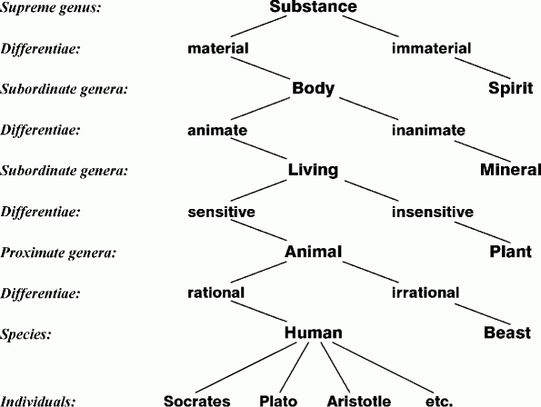
Classification systems
Tree of Portphyry, 3rd century AD, representing Aristotle categories

Slide 12
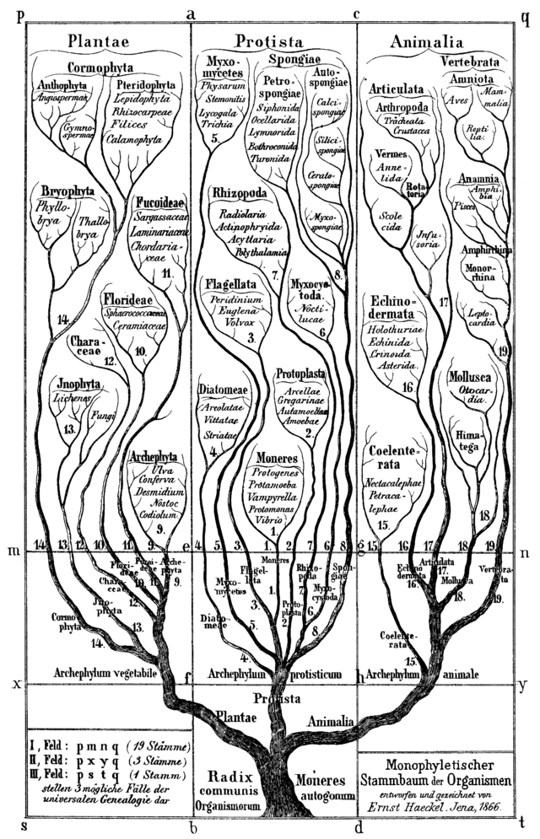
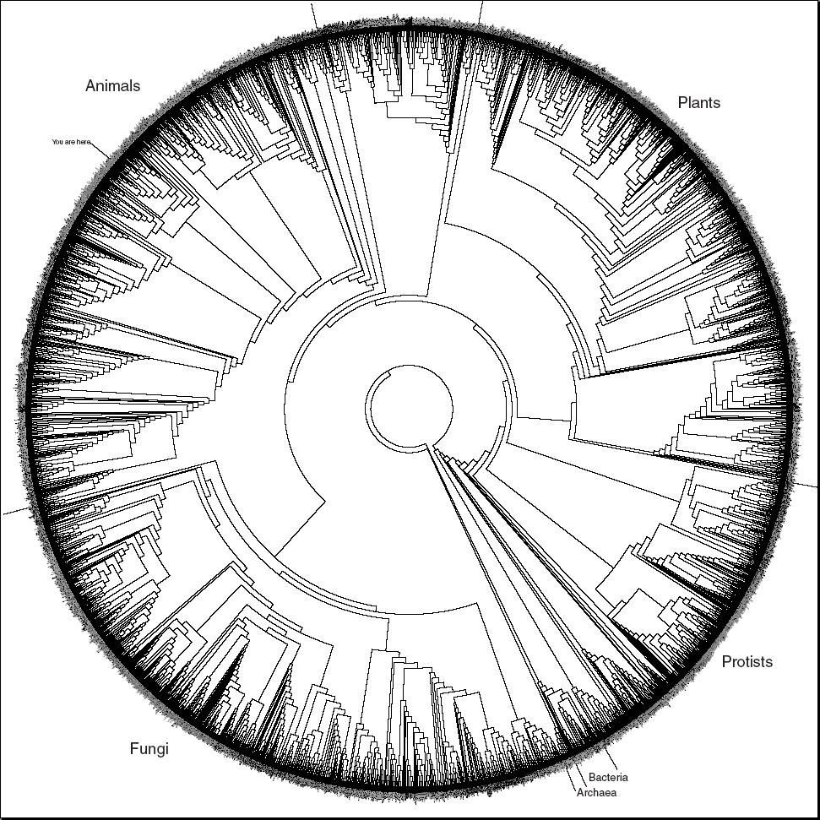
Classification systems
Biological taxonomy

Slide 13
Classification systems
Library classification
500 Natural sciences and mathematics
510 Mathematics
516 Geometry
516.3 Analytic geometries
516.37 Metric differential geometries
516.375 Finsler Geometry

Slide 14
Classification systems
General knowledge: Persons are Living-beings
Specific data: Aristotle is a Person
Conclusion: Aristotle is a Living-being
In first order logic:
∀x.Person(x) ⇒ Living-being(x)
Person(Aristotle)
⊨
Living-being(Aristotle)

Slide 15
Classification systems: guidelines
A name can only be used for one class
A word does not necessarily correspond to a class and vice versa
Use consistent naming convention (e.g., capital letters, singular nouns or noun phrases)
Define classes by analogy: similar structure, similar features

Slide 16
Classification systems: exercise
Définir une hiérarchie à partir des concepts suivants :
Athléthisme, Course, Football, FootballAméricain, Natation, NatationSynchronisée, Patinage, PatinageArtistique, PatinageDeVitesse, Relai, Ski, Sport, SportArtistique, SportCollectif, SportDeBalle, SportIndividuel, Tennis.

Slide 17
Graph-based knowledge representation
Classes are not enough to represent most knowledge
Relations between entities are required
E.g., what ingredients are in a dish?

Slide 18
Graph-based knowledge representation
Representing entities and their relationships:
mind maps
topic maps
semantic networks
conceptual graphs
RDF

Slide 19
Graph-based knowledge representation
Semantic networks: Describe particular entities
e.g., John knows Sam and is the son of Henry
In FOL: knows(John,Sam) ∧ son-of(John,Henry)
knows
John
son-of
Sam
Henry

Slide 20
Graph-based knowledge representation
Exercises:
describe pizza recipe as a semantic network
how to describe the pizza that I made yesterday?

Slide 21
Graph-based knowledge representation
Add two special relationships
is-a (between an entity and a class it belongs to)
kind-of (between a class and a superclass)
kind-of
Person
Living-being
is-a
is-a
John
son-of
Henry

Slide 22
Graph-based knowledge representation
Meaning of is-a and kind-of
We would like that this graph:
logically implies:
kind-of
Person
Living-being
is-a
is-a
John
son-of
Henry
John
is-a
Living-being

Slide 23
Graph-based knowledge representation
Meaning of is-a and kind-of
First interpretation:
means in FOL: C(e) for any e and C
and
means: ∀x.C(x) ⇒ D(x)
Problem: in this case, C is a predicate symbol and e is a constant but in the graph, they are both nodes. Nodes that are classes should be distinguished from nodes that are entities
e
is-a
C
kind-of
C
D

Slide 24
Graph-based knowledge representation
Meaning of is-a and kind-of
Second interpretation:
if
then
In FOL: ∀e∀C∀D.is-a(e,C) ∧ kind-of(C,D) ⇒ is-a(e,D)
e
is-a
C
kind-of
D
e
is-a
D

Slide 25
Graph-based knowledge representation
Exercise:
Complete your description of the cooking knowledge model with is-a and kind-of

Slide 26
Graph representation: generalising
We have seen a formalism that can express that a particular recipe (e.g., my mom’s omelette) has particular ingredients (e.g., 4 eggs). How do we represent the fact that recipes, in general, have ingredients?
hasIngredient
Recipe
Ingredient
?
is-a
is-a
myMumOmelette
hasIngredient
fourEggs

Slide 27
Graph representation: generalising
There are several interpretations of the relationship between classes
The class Recipe itself relates to the class Ingredient by relation hasIngredient hasIngredient(Recipe,Ingredient)
All recipes have some ingredients ∀x.∃y.Recipe(x) ⇒ Ingredient(y) ∧ hasIngredient(x,y) or ∀x.∃y.is-a(x,Recipe) ⇒ is-a(y,Ingredient) ∧ hasIngredient(x,y)
Recipes may have ingredients
hasIngredient
Recipe
Ingredient

Slide 28
Graph representation: generalising
There are several interpretations of the relationship between classes
The relation hasIngredient only relates recipes to ingredients ∀x.∃y.hasIngredient(x,y) ⇒ Recipe(x) ∧ Ingredient(y) or ∀x.∃y.hasIngredient(x,y) ⇒ is-a(x,Recipe) ∧ is-a(y,Ingredient)
hasIngredient
Recipe
Ingredient

Slide 29
Unknown values
What if I want to describe a recipe for which I do not know the cooking time?
What if I want to say something about a recipe that does not match a property of the class?
Open World Assumption vs. Closed World Assumption

Slide 30
Expressiveness vs. Complexity tradeoff
Expressiveness comes at the cost of complexity:
Complexity of design
Complexity of understanding
Complexity of computation
Principle of least power:
Always choose the least expressive language that suits your purposes

